Slide 1



Central Shenandoah Regional Housing Study
Jeremy Crute
Mel jones
Jonathan knopf

Slide 2





Regional Housing Study:
Overview
Localities expressed a strong need for a comprehensive regional housing study to address housing challenges.
The Study was funded by Virginia Housing’s Community Impact Grant program and involved consultants from the Virginia Center for Housing Research (VCHR) at Virginia Tech and HousingForward Virginia.
The housing study provides insights into housing accessibility, affordability, and diversity, and aims to support our localities make informed decisions and offer sustainable housing solutions.
Rockingham
County
Rockingham
County
Harrisonburg
Highland
County
Highland
County
Augusta
County
Augusta
County
Staunton
Bath
County
Waynesboro
Rockbridge
County
Rockbridge
County
Lexington
Buena Vista

Slide 3
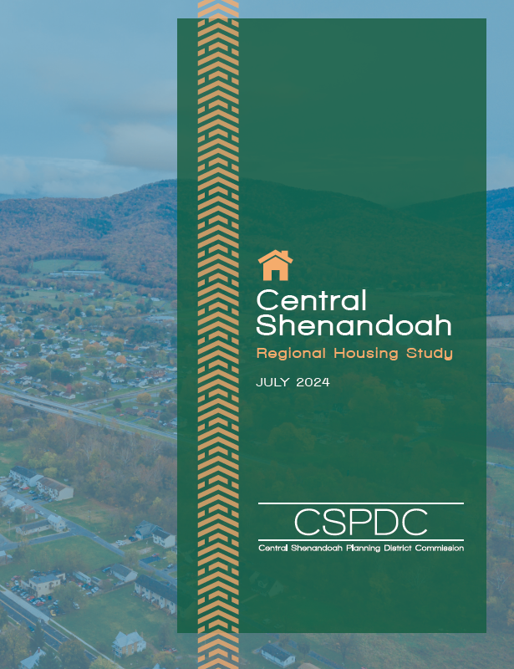
Regional Housing Study: Process
Listening sessions and other engagement
Data, policy, and document review
Phase I: Housing Data Analysis
Quantitative and Qualitative Data collection
Phase II: Housing Solution Development
Locality feedback
Preliminary solutions
Feedback and input
Revised solutions
Full study draft
Feedback and input
Final study

Slide 4
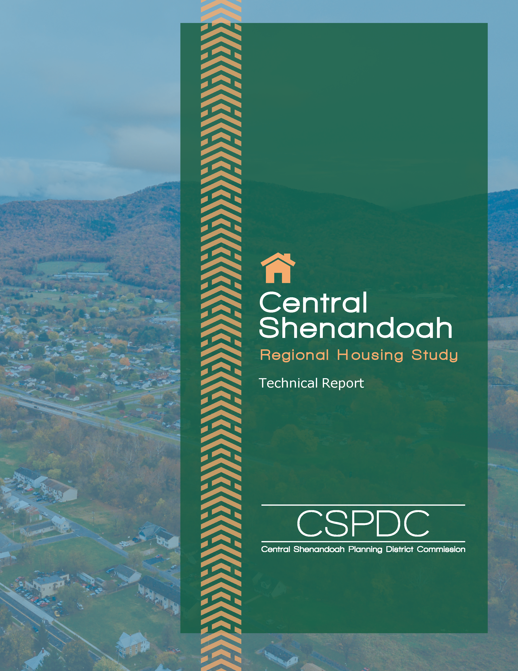
Regional Housing Study: Reports
Consumer Report
Summarizes key findings and recommended strategies
Technical Report
Provides more detailed data analysis and action steps
Both reports are available at:
https://connect.cspdc.org/cspdc-housing-study
Bath
County

Slide 5
Phase 1: Data Analysis
Housing Challenges
  Need for more homeownership opportunities
  Need for more rental opportunities
  Need for more variety in housing sizes and types
  Need to maintain quality housing conditions
  Need for more income-restricted, affordable housing

Slide 6
Regional Housing Study:
Regional and Local Solutions
REGIONAL
Address common issues and require high-level coordination across all localities.
Strategic priorities
Easy wins
Background work
LOCAL
Tailored to particular jurisdictions to address their community’s specific needs.
Priority solutions
Secondary solutions
Rockingham
County
Highland
County
Augusta
County
Bath
County
Rockbridge
County

Slide 7
Regional Housing Study: Regional Solutions
STRATEGIC PRIORITY Higher impact, higher complexity
▶ Establish hub for home improvement grants and resources
▶ Support permanent housing options to help end homelessness
Rockingham
County
Highland
County
Augusta
County
EASY WIN Higher impact, lower complexity
▶ Introduce community land trust homeownership model
Bath
County
Rockbridge
County
BACKGROUND WORK Lower impact, lower complexity
▶ Expand housing counseling services
▶ Pursue regional land bank entity

Slide 8
Regional Housing Study: Priority Solutions
Evaluate the feasibility of adopting density bonuses and an affordable housing dwelling unit ordinance to incentivize new affordable housing
Utilize grant funding to conduct a focused market analysis of density bonuses
Tee up successful zoning reform that ties bonuses to affordable housing goals
Lay groundwork for a comprehensive evaluation of financing tools for affordable housing
Apply for a Virginia Housing grant to fund an expert analysis of financing options
Rockingham
County
Highland
County
Augusta
County
Bath
County
Rockbridge
County

Slide 9
Regional Housing Study: Secondary Solutions
Develop a paired approach for regulating short-term rentals and accessory dwelling units
Consider how the zoning code could be revised to permit ADUs based on a review of other Virginia localities
Implement balanced regulations for STRs that preserve housing for long-term residents
Pursue strategies to preserve both subsidized and market-affordable rental housing
Preserve affordable rental housing units at-risk of expiring subsidies, market pressures, and redevelopment
Inventory and monitor at-risk properties
Consider preservation options:
  Local housing preservation fund
  Zoning changes
  Partnering with local non-profits
Rockingham
County
Highland
County
Augusta
County
Bath
County
Rockbridge
County

Slide 10



Thank you
Jeremy Crute
Director of Planning
CSPDC
jeremy@cspdc.org
Mel Jones
Co-Director
Virginia Center for Housing Research
mel.jones@vt.edu
Jonathan Knopf
Executive Director for Programs
HousingForward Virginia
jonathan@housingforwardva.org

